Slide 1
CS312 Artificial Intelligence
Lecture # 12
HITEC University, Taxila
Mr. Mubashir Iqbal
Fall-2025

Slide 2
Lecture Content
Introduction to Deep Learning
Introduction to Artificial Neural Networks (ANN)
Structure of ANN
Neuron and It’s Structure
Multi-Layer Perceptron (MLP) and Backpropagation
Activation Functions
Python Codes

Slide 3
Deep Learning

Slide 4

Deep Learning
Deep Learning is a technique in Artificial Intelligence where computers learn patterns from data using multiple layers of neural networks, just like how our brain uses neurons to process information.
It works especially well when the data is large and complex, such as images, videos, text, and audio.

Slide 5
Why do we call it “Deep”
Because the neural network has many hidden layers between the input and output.
Example:
Input Layer → Hidden Layer 1 → Hidden Layer 2 → Hidden Layer 3 → Output Layer
More layers = “Deeper” network.
Each layer learns something different:
Layer 1: Detects basic shapes
Layer 2: Detects edges and patterns
Layer 3: Recognizes parts of objects
Layer 4: Recognizes full objects
This is why deep learning is extremely powerful in image and speech recognition.

Slide 6
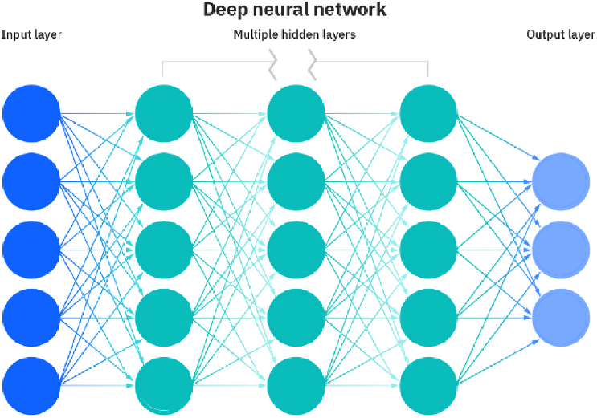
Deep Learning Architecture

Slide 7
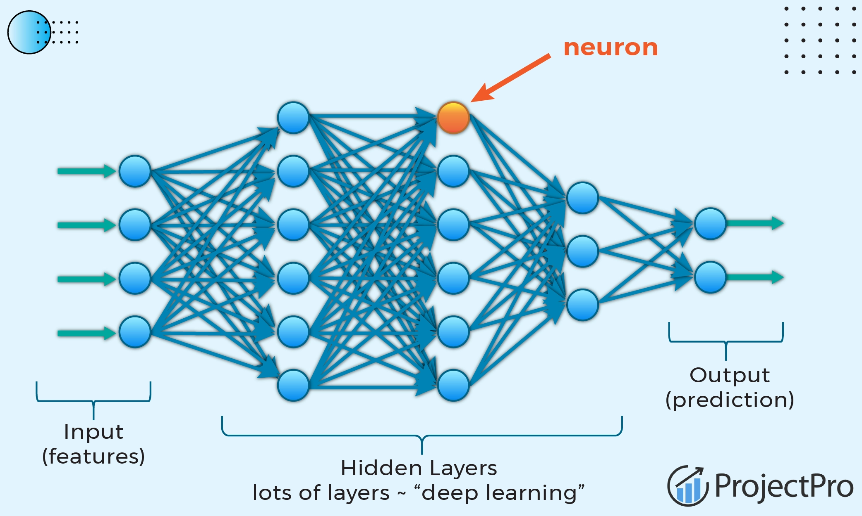
Deep Learning Architecture
Link: 8 Deep Learning Architectures Data Scientists Must Master

Slide 8
How Does Deep Learning Work?
Deep Learning works in 3 steps:
Step 1 — Input Data: You give the model some data:
A picture
A sentence
A sound clip
Sensor values
etc.
Step 2 — Learning Patterns: The network tries to find patterns in the data, such as:
Edges in an image
Meaning in a sentence
Trends in numerical data
It adjusts internal connections called weights to minimize errors.
Step 3 — Output: The network gives predictions such as:
Is this a cat or dog?
What is the next word?
What number will come next?

Slide 9
Deep Learning
Applications of Deep Learning
Self-driving cars: Detects roads, lanes, pedestrians
Face recognition: Unlocks your phone using your face
Google Translate: Understands and translates languages
ChatGPT: Understands text and generates responses
Medical diagnosis: Detects tumors in X-rays or MRI scans
Voice assistants: Siri, Alexa, Google Assistant speech recognition
Why is Deep Learning Important?
Because it can handle:
Large amounts of data
Unstructured data (images, audio, text)
Complex patterns
Traditional machine learning struggles in these situations.

Slide 10
Difference Between ML and DL
Machine Learning | Deep Learning
Works with small data | Needs large data
Needs manual feature extraction | Learns features automatically
Simple algorithms | Neural networks with many layers
Less computation | Requires GPU/TPU

Slide 11
Types of Neural Networks
Deep learning has different types of neural networks:
1. Artificial Neural Networks (ANN)
Basic form used for tabular data.
2. Convolutional Neural Networks (CNN)
Used for:
Images
Videos
Face recognition
3. Recurrent Neural Networks (RNN)
Used for:
Text
Speech
Time-series data

Slide 12
Types of Neural Networks
4. Transformers: Advanced architecture used in:
ChatGPT
BERT
Google Translate
Advantages of Deep Learning
Learns automatically
Handles complex problems
Works well with unstructured data
Achieves high accuracy
Disadvantages of Deep Learning
Needs lots of data
Requires powerful hardware (GPU)
Training takes time
Hard to interpret (black-box nature)

Slide 13
Artificial Neural Networks (ANN)

Slide 14
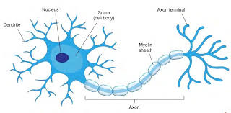
Artificial Neural Networks (ANN)
An ANN is a machine learning model that tries to mimic how our brain processes information. It consists of layers of small processing units called artificial neurons that work together to solve complex problems.
Just like the human brain has neurons that are connected by synapses, an ANN has:
So ANN is a simplified digital version of how the brain learns.
Biological Brain | Artificial Neural Network
Neurons | Artificial Neurons (nodes)
Synapses | Weights
Neuron Activation | Activation Function
Learning | Adjusting weights

Slide 15
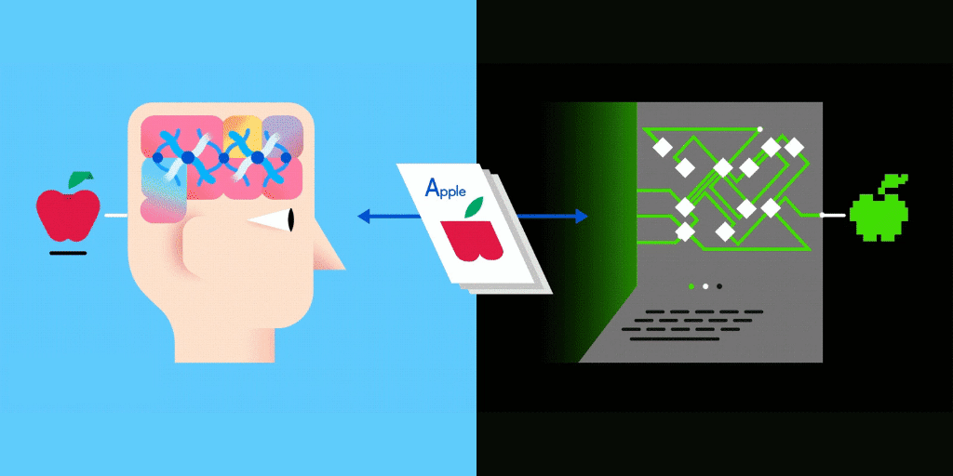
Artificial Neural Networks (ANN)

Slide 16
How ANN Learns?
ANN learns through a process called training:
Step 1: Forward Propagation
Data flows from input → hidden layers → output
ANN makes a prediction
Step 2: Calculate Error
Compare prediction with actual value
Compute loss (how wrong the model is)
Step 3: Backpropagation
ANN adjusts weights to reduce error
It “learns” from mistakes
This cycle continues until the network becomes accurate.

Slide 17
Artificial Neural Networks (ANN)
Application | Use of ANN
Email spam detection | Classifies spam vs. non-spam
Medical diagnosis | Predicts disease risk
Stock market | Predicts price movements
Weather forecasting | Predicts temperature or rain
Banking | Fraud detection
Finance | Credit score prediction

Slide 18
Artificial Neural Networks (ANN)
Advantages of ANN
Learns automatically
Handles complex and noisy data
Can approximate any function
Scales well with large datasets
Disadvantages of ANN
Needs a lot of data
Requires powerful hardware
Hard to interpret (“black box”)
Can overfit if not tuned properly

Slide 19

Structure of an ANN

Slide 20
Types of Layers in an ANN
An ANN has 3 main types of layers:
1. Input Layer
Takes the raw data (numbers, pixels, features).
Example: image pixels, temperature values.
2. Hidden Layers
Perform mathematical operations.
Learn patterns in the data automatically.
More hidden layers = deeper network.
3. Output Layer
Produces the final prediction.
Example: class label, number, category.

Slide 21
Structure of an ANN
An ANN is built from layers of interconnected processing units called artificial neurons. The complete structure consists of:
Input Layer
Hidden Layer(s)
Output Layer
Forward Propagation
Backpropagation
Learning Rate
Loss Function
Each part plays an important role in how the network learns, processes information, and makes predictions.

Slide 22
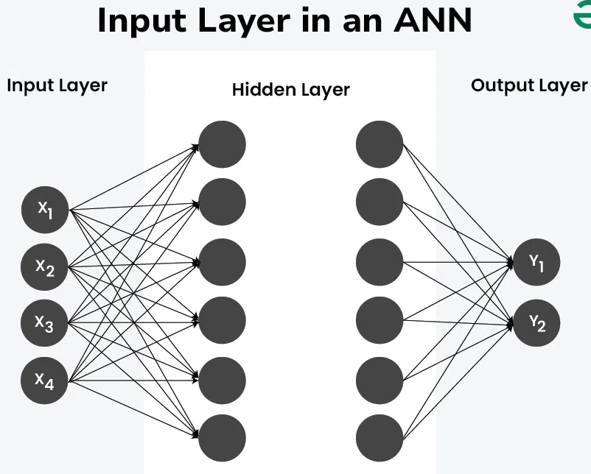
Structure of an ANN
Input Layer
The first layer of the ANN.
It receives the raw data and passes it into the network.
What It Does:
Does not perform any calculations.
Simply distributes input values to the next layer.
Example:
If your dataset has:
Age
Income
Education level
Then the input layer has 3 neurons, one for each feature.

Slide 23
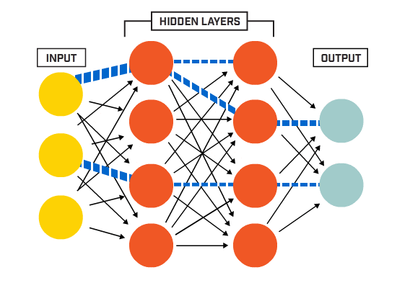
Structure of an ANN
2. Hidden Layers
Layers between input and output layers.
Can be one layer (shallow) or many layers (deep neural network).
What They Do:
Perform mathematical computations.
Extract patterns and relationships.
Transform inputs into useful representations.
Deep vs Shallow:
Shallow ANN = 1 hidden layer
Deep Neural Network (DNN) = 2 or more hidden layers
Example:
Hidden layers may learn:
Shapes in images
Trends in sales
Indicators of fraud

Slide 24
Structure of an ANN
3. Output Layer
The final layer of the ANN.
Produces the prediction or classification.
Type of Output Depends on Task:
Problem Type | Output Layer
Binary classification | 1 neuron (0 or 1)
Multiclass classification | One neuron per class
Regression | One neuron (continuous value)

Slide 25
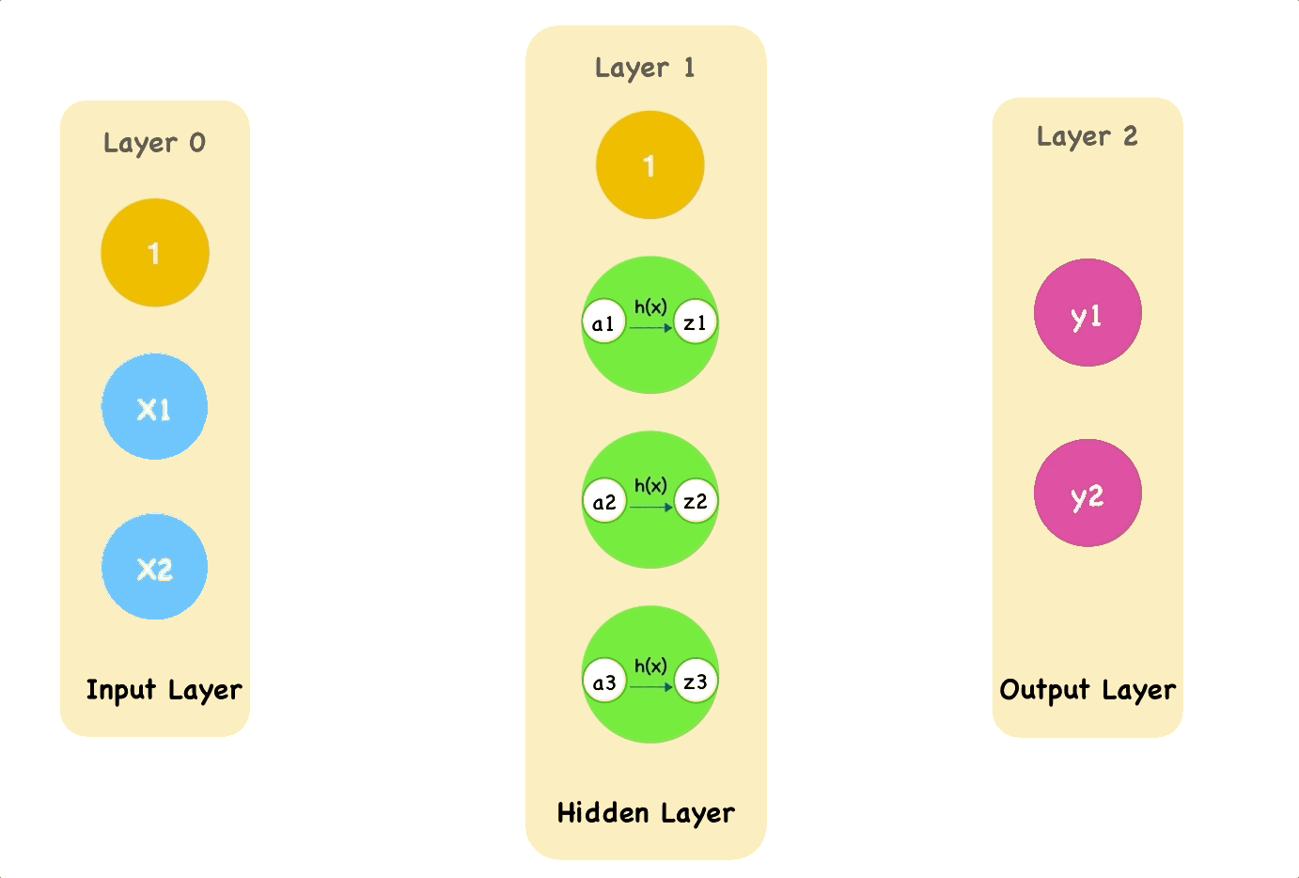
Structure of an ANN
4. Forward Propagation
The process of passing input data through the layers to generate output.
Steps:
Multiply inputs by weights
Add bias
Apply activation function
Send to next layer
This continues until the output layer
produces a final prediction.

Slide 26
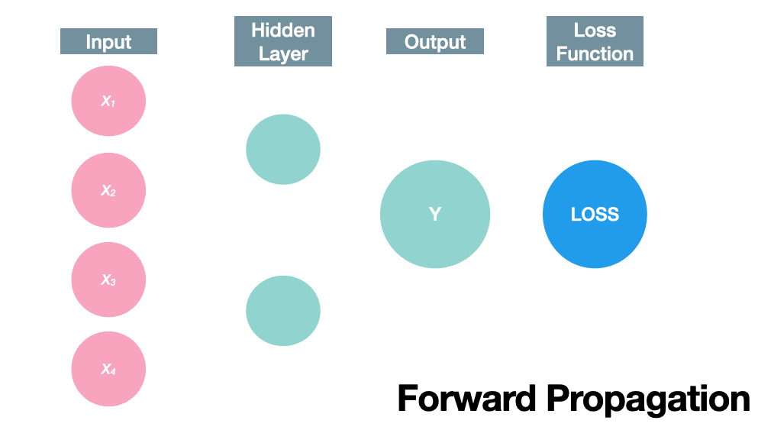
Structure of an ANN
6. Backpropagation
A learning algorithm used to update weights and biases based on error.
How It Works:
ANN makes a prediction
Loss is calculated
Error is propagated backward
Weights and biases are adjusted
Purpose:
To reduce future errors by improving accuracy.

Slide 27
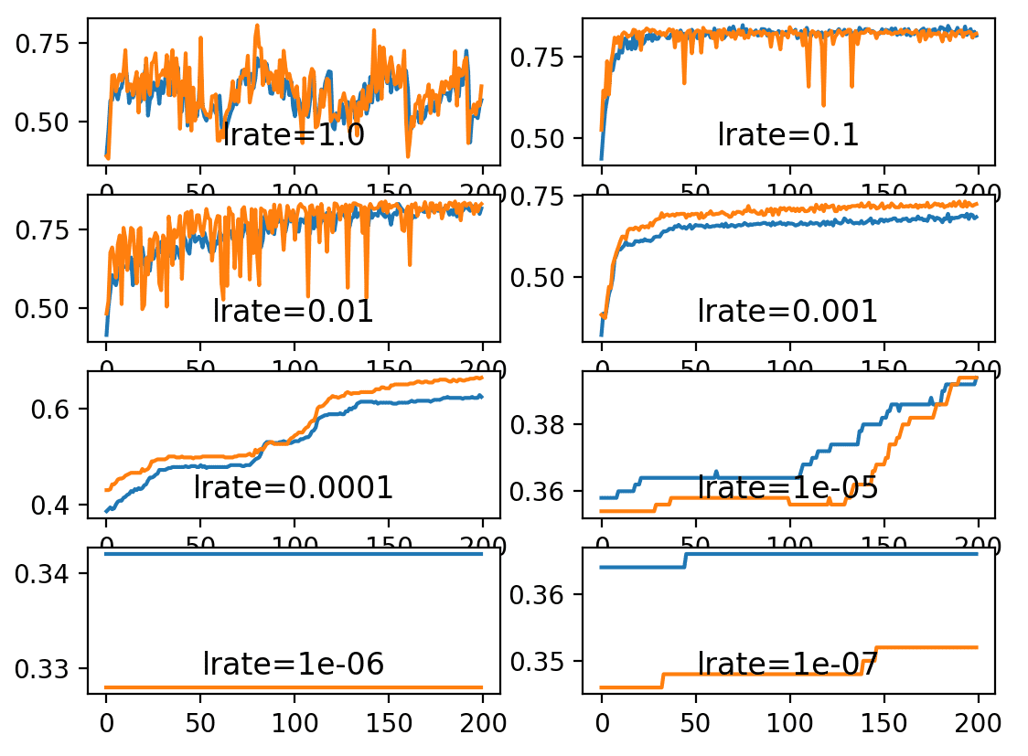
Structure of an ANN
7. Learning Rate
A hyperparameter that controls how fast the model changes weights during learning.
Too High:
Model jumps around
Fails to converge
Too Low:
Model learns very slowly
Requires many iterations
Link: Understand the Impact of Learning Rate on Neural Network Performance - MachineLearningMastery.com

Slide 28
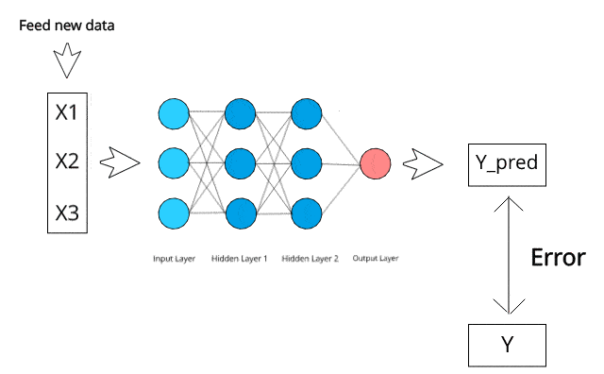
Structure of Neuron
8. Loss Function
A mathematical function that measures how wrong the network’s prediction is.
Purpose:
The goal in training is to minimize the loss.
Examples:
Mean Squared Error (MSE) → for regression
Cross-Entropy Loss → for classification

Slide 29
Artificial Neuron

Slide 30
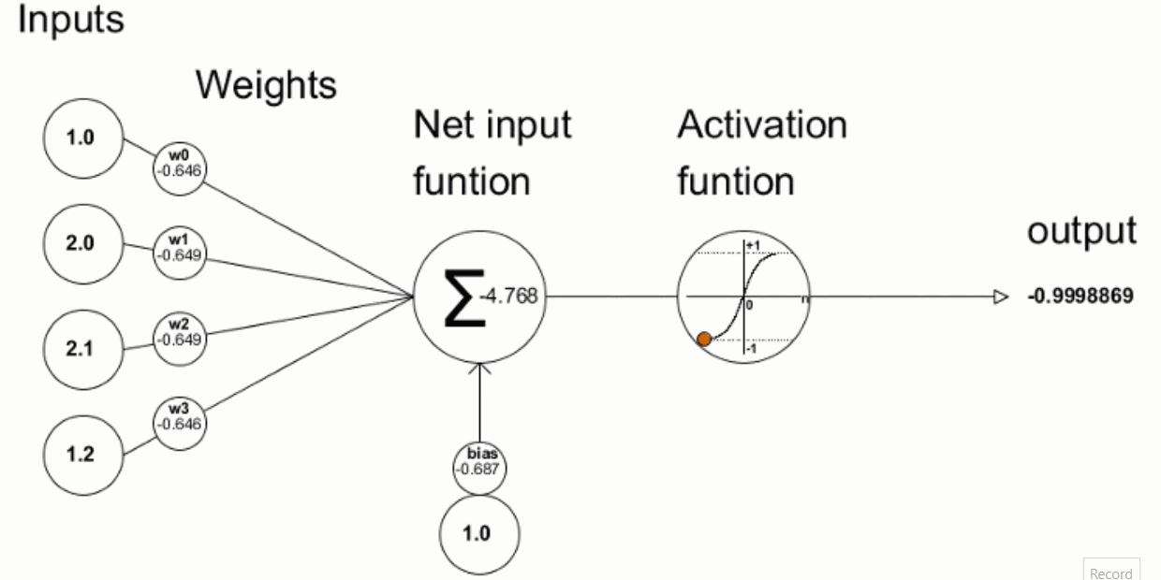
Artificial Neuron
An artificial neuron (also called a “perceptron” or “node”) is a mathematical model inspired by the biological neuron. Just like a biological neuron receives signals, processes them, and produces an output, an artificial neuron performs similar computational steps.
An artificial neuron consists of the following components:
Inputs (x₁, x₂, x₃, …)
Weights (w₁, w₂, w₃, …)
Summation Function
Bias (b)
Activation Function (f)
Output (y)

Slide 31
Structure of Neuron
1. Inputs (x)
Inputs are the features or values fed into the neuron.
Each input represents a piece of data.
Example:
For predicting house price:
x₁ = size
x₂ = number of rooms
x₃ = location score

Slide 32
Structure of Neuron
2. Weights
Numerical values connecting neurons between layers.
Represent the strength or importance of a connection.
Weights determine the importance or contribution of each input.
Each input has an associated weight.
Purpose:
A larger weight means that input has a stronger influence on the neuron's output.
Example:
If weight w₂ is high, feature x₂ heavily affects the decision.

Slide 33
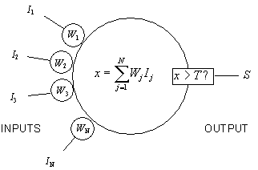
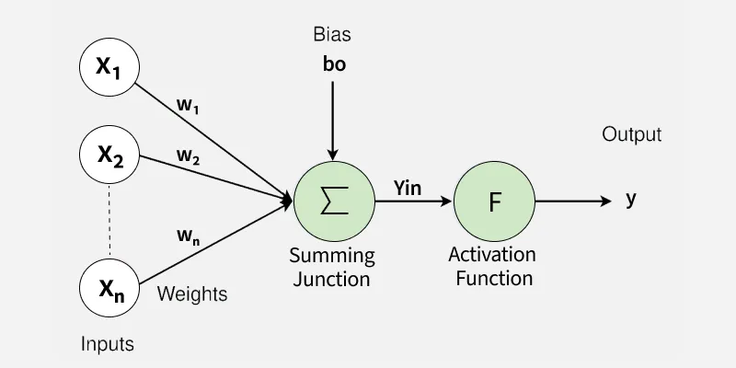
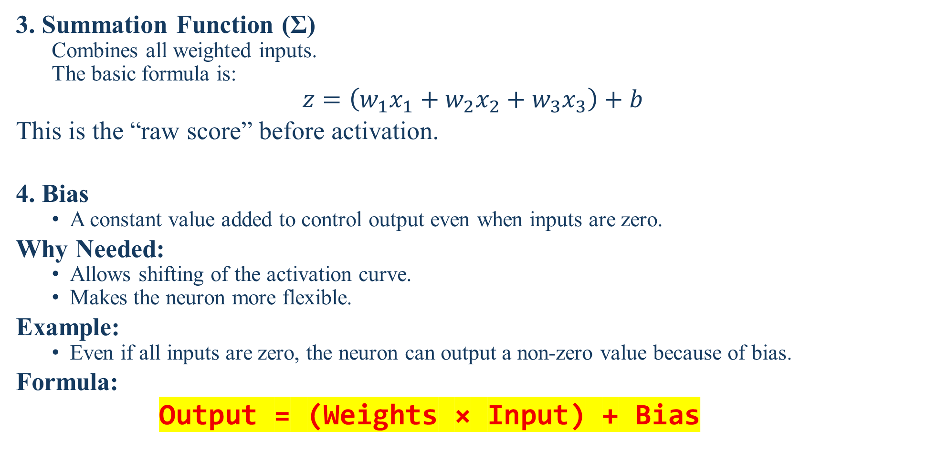
Structure of Neuron
3. Summation Function (Σ)
Combines all weighted inputs.
The basic formula is:
$$z=\left(w_{1}x_{1}+w_{2}x_{2}+w_{3}x_{3}\right)+b$$
This is the “raw score” before activation.
4. Bias
A constant value added to control output even when inputs are zero.
Why Needed:
Allows shifting of the activation curve.
Makes the neuron more flexible.
Example:
Even if all inputs are zero, the neuron can output a non-zero value because of bias.
Formula:
Output = (Weights × Input) + Bias

Slide 34
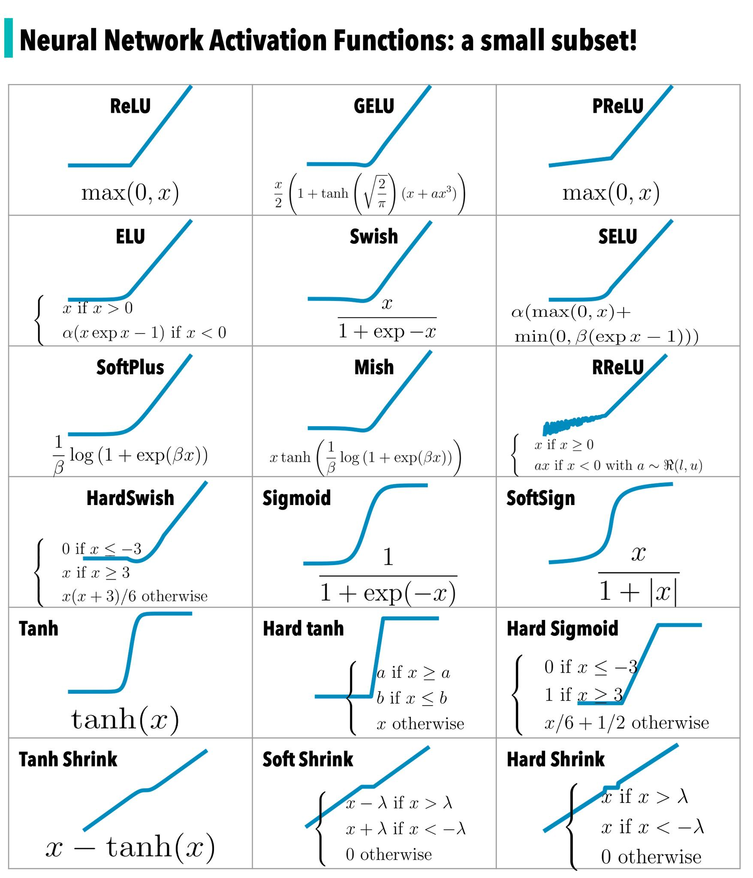
Structure of Neuron
5. Activation Functions
Mathematical functions applied to neuron outputs.
Purpose:
Introduce non-linearity, enabling ANN to learn complex patterns.
Common Activation Functions:
ReLU → f(x) = max(0, x)
Sigmoid → output between 0 and 1
Tanh → output between -1 and 1
Why Needed:
Without activation functions, ANN would behave like a simple linear model and fail on complex problems like image or speech recognition.

Slide 35
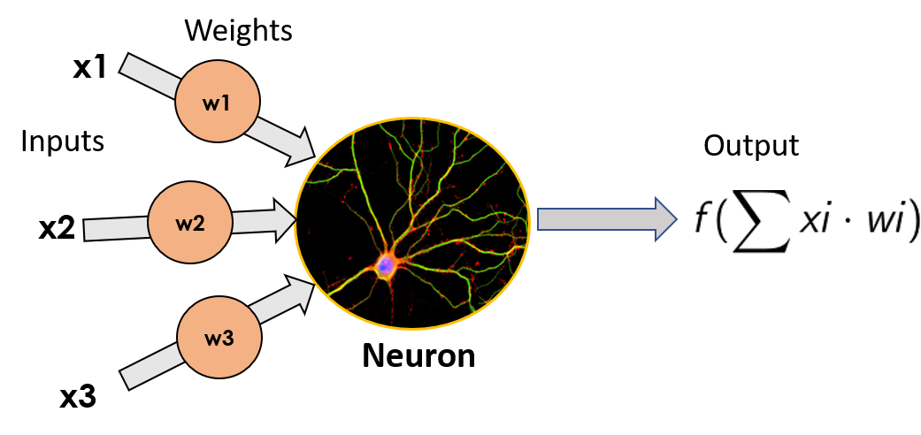
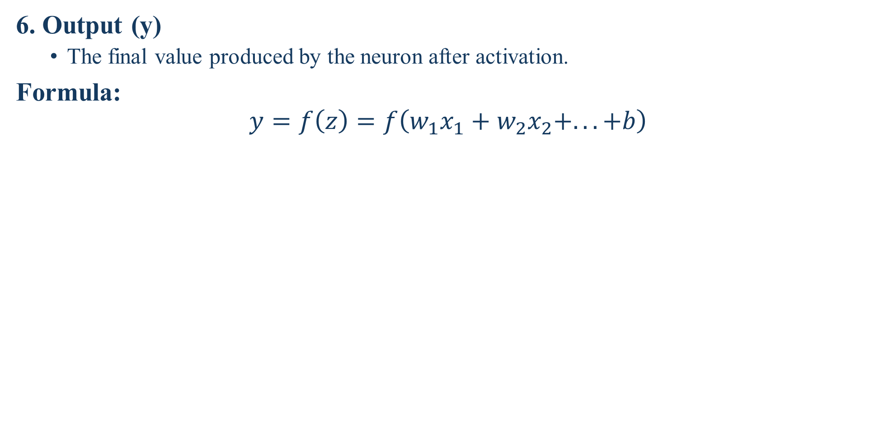
Structure of Neuron
6. Output (y)
The final value produced by the neuron after activation.
Formula:
$$y=f\left(z\right)=f\left(w_{1}x_{1}+w_{2}x_{2}+...+b\right)$$

Slide 36
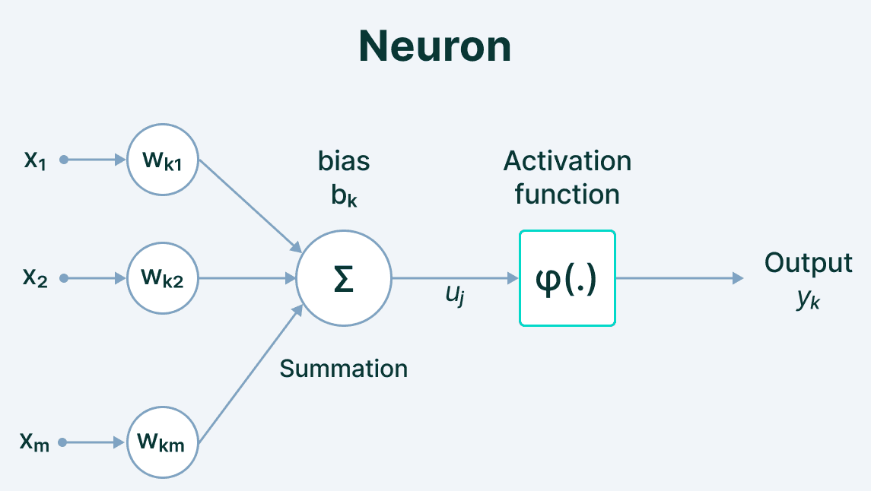
Structure of Neuron
The Essential Guide to Neural Network Architectures

Slide 37
Multi-Layer Perceptron (MLP)

Slide 38
Multi-Layer Perceptron (MLP)
An MLP is a basic type of artificial neural network that can learn complex patterns from data, like recognizing handwritten digits or predicting if an email is spam.
It’s Made of Layers
1. Input Layer: Receives the data (e.g., pixel values of an image, or features like age, income).
2. Hidden Layer(s): One or more layers that process the input and find hidden patterns. → This is where the “learning” happens!
3. Output Layer: Gives the final answer (e.g., “spam” or “not spam”, or a number like house price).
Even one hidden layer makes it a multi-layer perceptron!

Slide 39
Multi-Layer Perceptron (MLP)
Why “Perceptron”?
A single-layer perceptron can only solve very simple problems (like AND/OR logic).
But real-world data (like images or text) is not linearly separable.
MLP adds hidden layers → can learn non-linear patterns (curves, complex shapes)!
Example: A single line can’t separate cats from dogs in a photo, but an MLP can learn complex boundaries!

Slide 40
Multi-Layer Perceptron (MLP)
Important Points
MLP = Feedforward Neural Network with ≥1 hidden layer.
Can solve non-linear problems (unlike simple perceptrons).
Learns by adjusting weights during training.
Foundation for deep learning (when you add many layers!).
Used for classification & regression (e.g., digit recognition, price prediction).
Limitations
Not good for raw images/audio/text → needs feature engineering (unless combined with CNNs/RNNs).
Can overfit if too big or trained too long.
“Black box” – hard to interpret why it made a decision (link to your XAI interest!).

Slide 41
Multi-Layer Perceptron (MLP)
How Does It Learn?
Uses backpropagation + gradient descent.
Compares its prediction with the correct answer.
Adjusts weights a little bit to reduce error.
Repeats this over many examples (training).
Like practicing math: make a mistake → learn from it → get better!

Slide 42
Backpropagation

Slide 43
Backpropagation
Backpropagation is the “learning method” that teaches a neural network (like an MLP) to get better by fixing its mistakes step by step, from output back to input. Think of it as “learning from errors in reverse”.
Why Do We Need It?
A neural network starts with random weights → makes wrong predictions.
We need a way to adjust those weights so the network gets smarter.
Backpropagation calculates how much each weight contributed to the error—so we can fix it!
Goal: Minimize prediction error over time.

Slide 44
Backpropagation
How Does It Work? (Step-by-Step)
Step 1: Forward Pass
Input data flows forward through the network.
The network makes a prediction.
We compare it to the true answer → calculate error (e.g., using Mean Squared Error or Cross-Entropy).
Example: True label = “Cat” → Network says “Dog” → Big error!
Step 2: Backward Pass (Backpropagation!)
The error is sent backward through the network.
Using calculus (chain rule),
it computes:
“How much did each weight cause this error?” → This is called the gradient (or partial derivative).
These gradients tell us:
Which weights to increase
Which weights to decrease

Slide 45
Backpropagation
Step 3: Update Weights
Use an optimizer (like Gradient Descent) to adjust weights:
New Weight = Old Weight – (Learning Rate × Gradient)
Learning rate: Controls how big a step to take (too big → overshoot; too small → slow learning).
Small, smart steps → better model

Slide 46
Backpropagation
Common Misconceptions
“Backpropagation = Neural Network” → No! It’s just the learning method.
“It updates weights randomly” → No! Updates are mathematically precise based on error.
“It works in one step” → No! Needs many iterations (epochs) to learn well.
Real-Life Analogy: Learning to ride a bicycle:
You fall (error!).
You think: “Was it my balance? Pedal speed? Steering?” (backpropagation).
Next time, you adjust just the right thing (weight update).
After many tries, you ride smoothly! 🚲

Slide 47
Activation Functions

Slide 48
Activation Functions
An activation function decides whether a neuron should “fire” (send a signal) or not—based on its input.
It adds non-linearity to the network so it can learn complex patterns (like curves, spirals, or real-world data). Without activation functions, a neural network is just a fancy linear equation—even with 100 layers!
Why Do We Need It?
A neuron computes: output = weights × inputs + bias → this is linear.
But real-world data (images, speech, text) is non-linear.
The activation function “squishes” or transforms this output into a useful range—and enables learning of complex relationships.
Key role: Makes neural networks powerful and flexible.

Slide 49
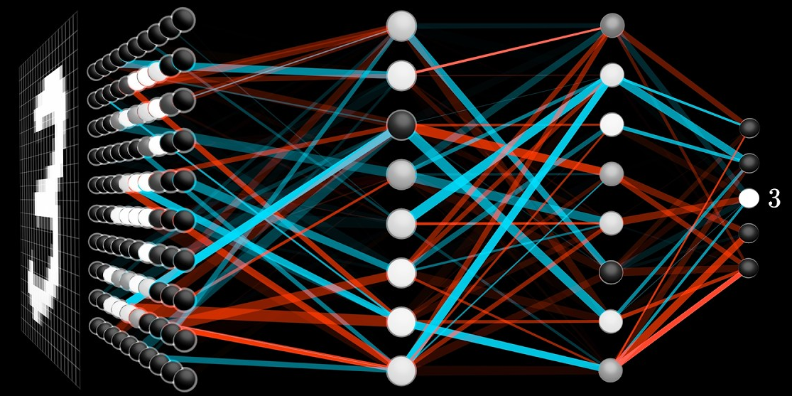

Slide 50
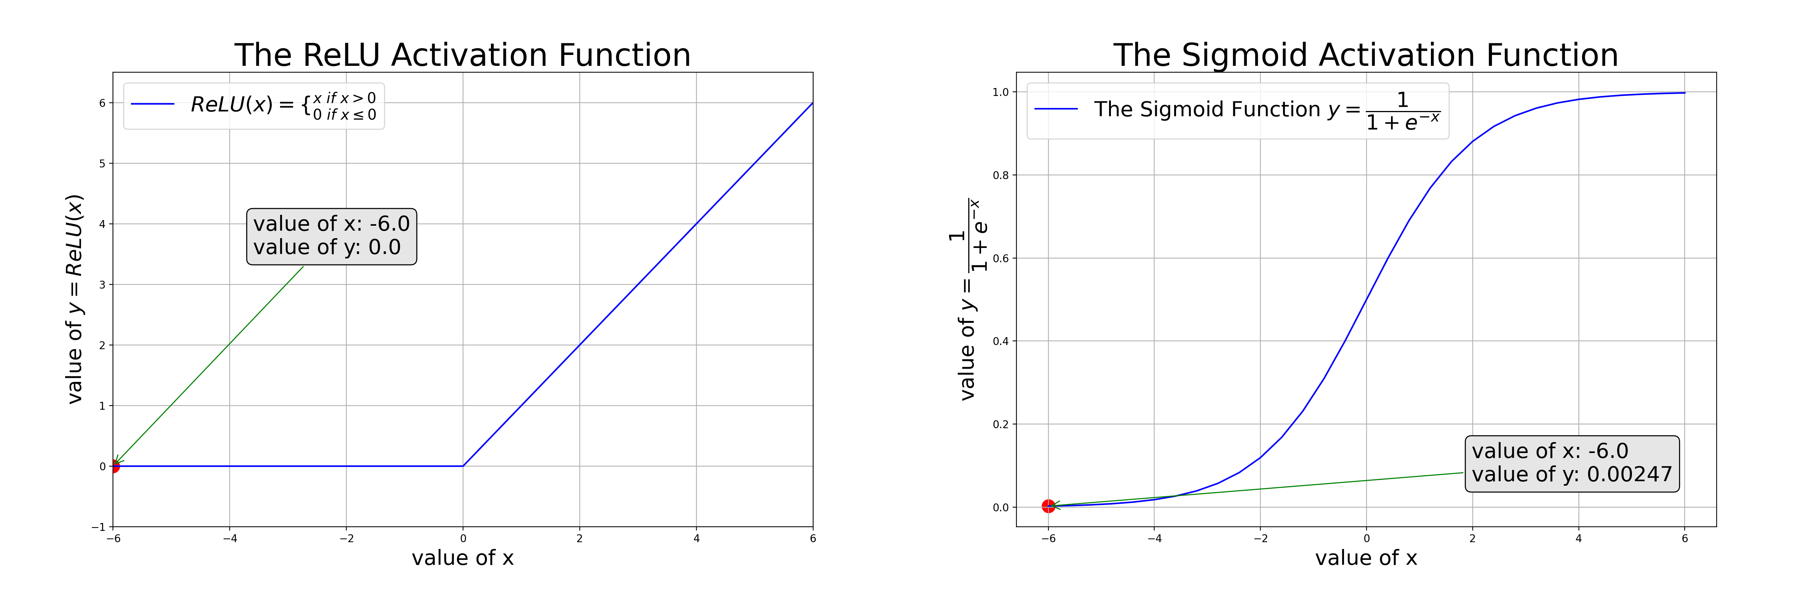
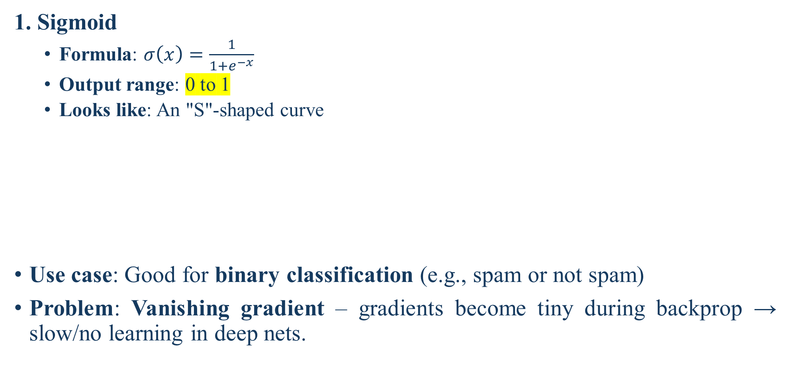
Common Activation Functions
1. Sigmoid
Formula: $σ\left(x\right)=\frac{1}{1+e^{−x}}$
Output range: 0 to 1
Looks like: An "S"-shaped curve
Use case: Good for binary classification (e.g., spam or not spam)
Problem: Vanishing gradient – gradients become tiny during backprop → slow/no learning in deep nets.

Slide 51
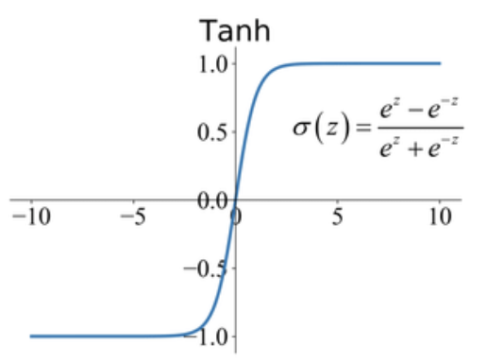
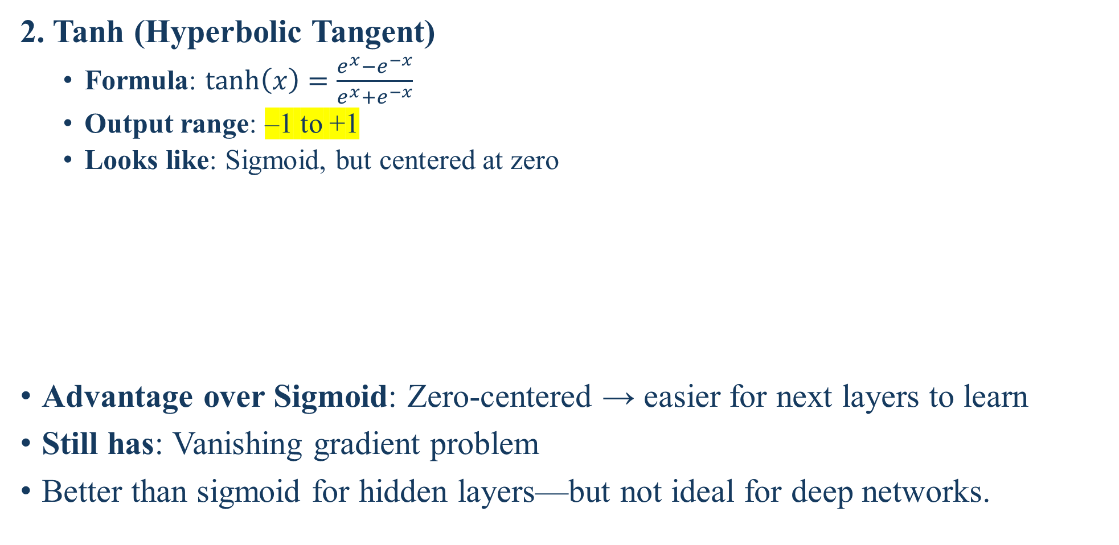
Common Activation Functions
2. Tanh (Hyperbolic Tangent)
Formula: $tanh⁡\left(x\right)=\frac{e^{x}−e^{−x}}{e^{x}+e^{−x}}$
Output range: –1 to +1
Looks like: Sigmoid, but centered at zero
Advantage over Sigmoid: Zero-centered → easier for next layers to learn
Still has: Vanishing gradient problem
Better than sigmoid for hidden layers—but not ideal for deep networks.

Slide 52
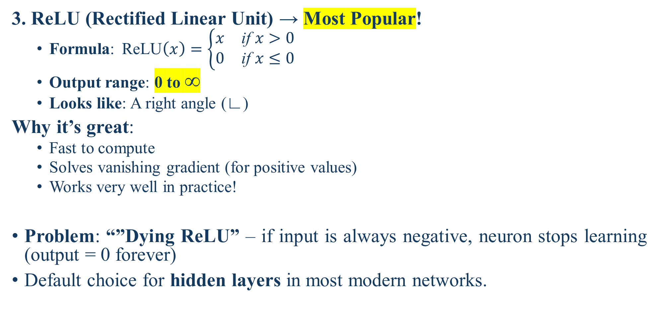
Common Activation Functions
3. ReLU (Rectified Linear Unit) → Most Popular!
Formula:$\text{ReLU}\left(x\right)=\left\{\begin{matrix}x & \text{if} x>0 \\ 0 & \text{if} x≤0\end{matrix}\right.$
Output range: 0 to ∞
Looks like: A right angle (∟)
Why it’s great:
Fast to compute
Solves vanishing gradient (for positive values)
Works very well in practice!
Problem: “”Dying ReLU” – if input is always negative, neuron stops learning (output = 0 forever)
Default choice for hidden layers in most modern networks.

Slide 53
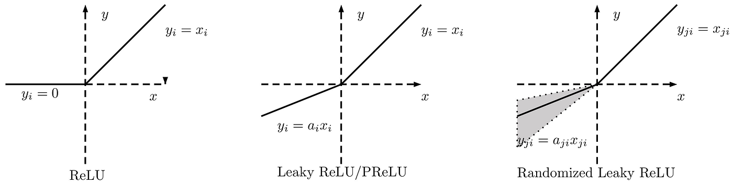
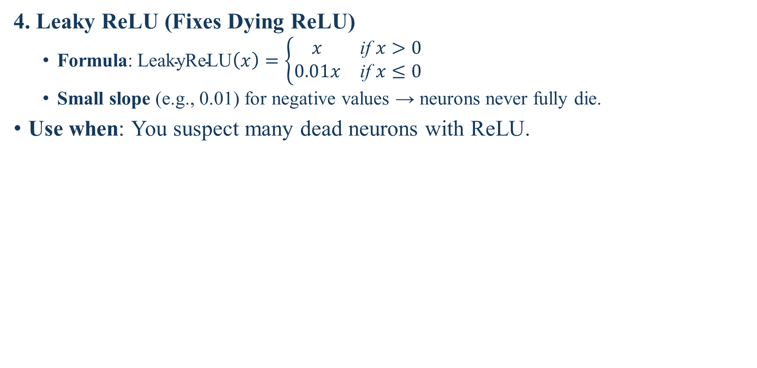
Common Activation Functions
4. Leaky ReLU (Fixes Dying ReLU)
Formula:$\text{LeakyReLU}\left(x\right)=\left\{\begin{matrix}x & \text{if} x>0 \\ 0.01x & \text{if} x≤0\end{matrix}\right.$
Small slope (e.g., 0.01) for negative values → neurons never fully die.
Use when: You suspect many dead neurons with ReLU.

Slide 54
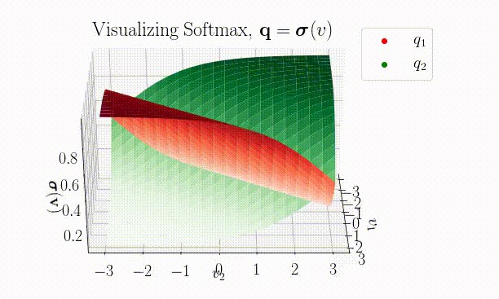
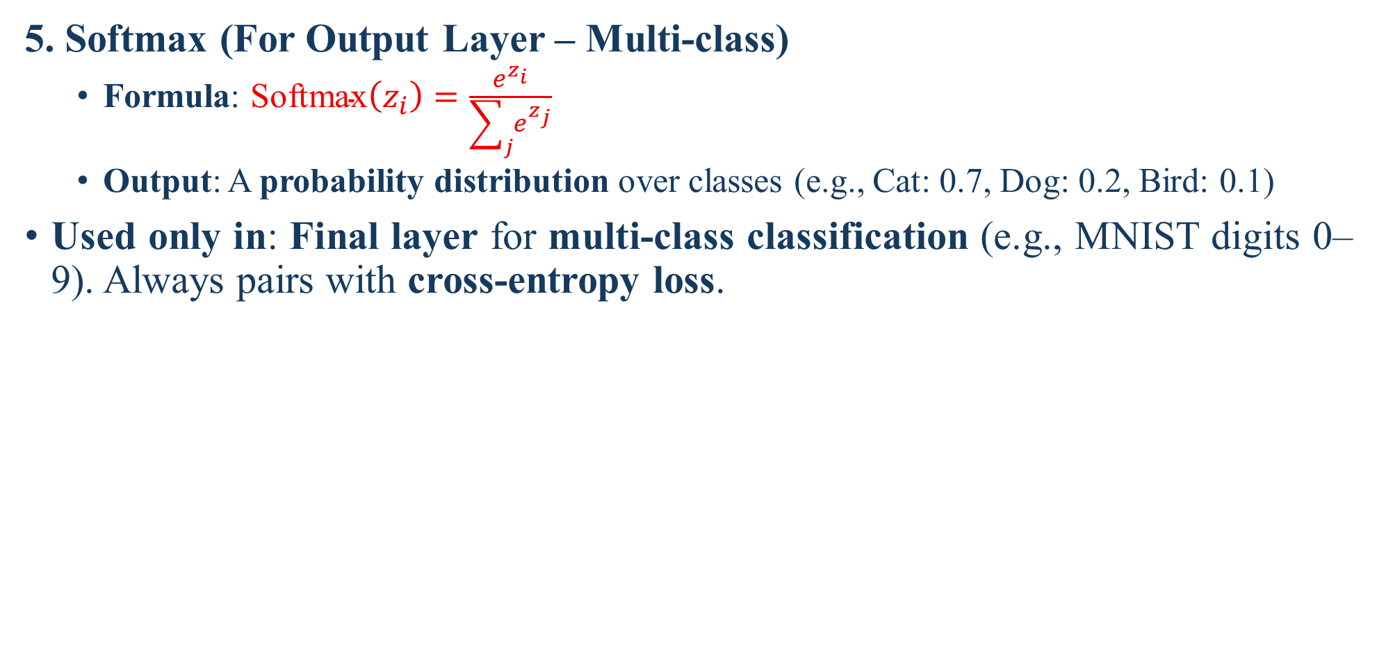
Common Activation Functions
5. Softmax (For Output Layer – Multi-class)
Formula: $\text{Softmax}\left(z_{i}\right)=\frac{e^{z_{i}}}{\sum_{j}{e^{z_{j}}}}$
Output: A probability distribution over classes (e.g., Cat: 0.7, Dog: 0.2, Bird: 0.1)
Used only in: Final layer for multi-class classification (e.g., MNIST digits 0–9). Always pairs with cross-entropy loss.

Slide 55
Python Code to Make a Deep Learning Model

Slide 56
Simple ANN Model using TensorFlow & Keras
# Step 1: Import required libraries
import tensorflow as tf
from tensorflow.keras.models import Sequential
from tensorflow.keras.layers import Dense
model = Sequential() #Step 2: Create a Sequential Model
model.add(Dense(32, activation='relu', input_shape=(10,))) #Step 3: Add Input Layer + First Hidden Layer
model.add(Dense(16, activation='relu')) #Step 4: Add Second Hidden Layer
model.add(Dense(8, activation='relu’)) #Step 5: Add Third Hidden Layer
model.add(Dense(1, activation='sigmoid’)) #Step 6: Add Output Layer #Sigmoid is used for binary classification
model.compile(optimizer='adam’, loss='binary_crossentropy’, metrics=['accuracy’]) #Step 7: Compile the Model
model.summary() #Step 8: Display Model Summary
history = model.fit(X_train, y_train, epochs=20, batch_size=8) #Step 9: Train the ANN
loss, accuracy = model.evaluate(X_train, y_train) #Step 10: Evaluate the Model
print(f"Training Accuracy = {accuracy*100:.2f}%")

Slide 57
Simple MLP Model
import tensorflow as tf
from tensorflow.keras.models import Sequential
from tensorflow.keras.layers import Dense
# Create a Sequential MLP Model
mlp = Sequential()
mlp.add(Dense(64, activation='relu', input_shape=(20,)))
mlp.add(Dense(32, activation='relu'))
mlp.add(Dense(16, activation='relu'))
mlp.add(Dense(1, activation='sigmoid’)) # Output Layer (binary classification)
# Compile the model
mlp.compile(optimizer='adam’, loss='binary_crossentropy’, metrics=['accuracy'])
mlp.summary() # Display architecture

Slide 58

Recap
Introduction to Deep Learning
Introduction to Artificial Neural Networks (ANN)
Structure of ANN
Neuron and It’s Structure
Multi-Layer Perceptron (MLP) and Backpropagation
Activation Functions

Slide 59

Not included in Syllabus
If you were taking a nap, wake up… the lecture is over!

